Slide 1
Real-time Realistic Ocean
Yehua Lyu, Anda Li

Slide 2
Tasks
Surface generation
Fourier transform
Spectrum generation
Lighting
Normal
Specular
BRDF

Slide 3
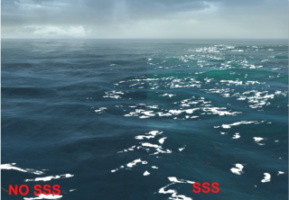
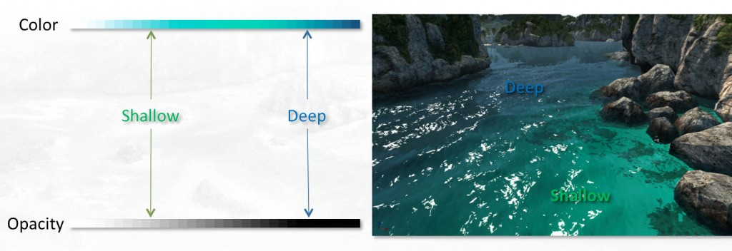
Possible Extra Features
Color blending
Subsurface scattering
Interaction with objects

Slide 4
Surface Generation
Spectrum Generation
Low Frequency
High Frequency
Adjustments
“A unified directional spectrum for long and short wind-driven waves” - T. Elfouhaily, B. Chapron, and K. Katsaros

Slide 5
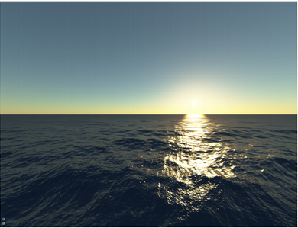
Lighting
Real-time Realistic Ocean Lighting using Seamless Transitions from Geometry to BRDF
Eric Bruneton and Fabrice Neyret and Nicolas Holzschuch

Slide 6
Demo

